Slide 1
Class 18
Scale Economies and Imperfect Competition by
Alan V. Deardorff
University of Michigan
2022
PubPol/Econ 541

Slide 2
Quiz
 | Q5 | Q6 | Q7 | Q8
Mean | 8.62 | 7.20 | 7.20 | 7.43
Median | 9 | 8 | 7.5 | 7
Max | 10 | 9.5 | 10 | 10
Min | 6 | 3 | 3.5 | 4.5
S.D. | 1.21 | 1.86 | 1.65 | 1.74

Slide 3
Paper 2
Due Thursday 8:30 AM
This time Canvas should be set for one submission per group.
I’m still available for group zooms if needed

Slide 4
Pause for News

Slide 5
Assumptions
Old Trade Theories | New Trade Theories | New new (Melitz)
Constant returns to scale | Increasing returns to scale | Increasing returns to scale
Perfect competition | Imperfect competition | Imperfect competition
Homogeneous products | Differentiated products | Differentiated products
Firms irrelevant | Firms identical | Firms heterogeneous

Slide 6
Outline
Scale Economies
Monopolistic Competition
Heterogeneous Firms

Slide 7
Pause for Discussion

Slide 8
  Questions on KOM
What are economies of scale, and how do external economies of scale differ from internal economies of scale?
What are some reasons why the costs of a number of firms producing the same thing might be lower if they are located close together than if they are far apart?

Slide 9
Outline
Scale Economies
Monopolistic Competition
Heterogeneous Firms

Slide 10
Scale Economies
With scale economies, average cost falls with higher output
Equilibrium is output at which P=AC
  i.e., zero excess profit
Dynamics
  Think of arbitrary output causing price from D-curve
  Profit (P>AC) causes expansion
  Loss (P<AC) causes contraction
  Market is stable if D steeper than AC
P, AC
P₁
P₀
AC
P₂
D
Q₁
Q₀
Q₂
Q

Slide 11
Scale Economies
P, AC
Contrary to usual markets, a rightward shift in demand causes price to fall
P₀
AC
P₁
D’
D
Q₀
Q₁
Q

Slide 12
Two-Country Autarky and Trade
Suppose US has higher cost than China
Without trade
  US has P₀^{U}=AC^{U}
  China has P₀^{C}=AC^{C}
With trade, China underprices US and takes the whole world market
Price falls in both countries and demanders gain in both, the US by more
P, AC
P₀^{U}
P₀^{C}
AC^{U}
P₁^{W}
AC^{C}
D^{C}
D^{U}
D^{W}=D^{C}+D^{U}
Q₁^{U}
Q₀^{C}
Q₀^{U}
Q₁^{C}
Q
NOTE: Here the country with lower AC curve also has lower autarky price and exports the good. Those won’t always be the case. See next.

Slide 13
Case of Less Demand in Low-Cost Country
P, AC
Now, with less demand, China’s autarky price is higher than the US, even though AC curve is lower
With trade, US underprices China even though it has the higher AC curve, and US takes the whole world market
Price falls in both countries and demanders gain in both, the US by less
World would benefit more if somehow China took whole market at Q^{Opt}
P₀^{C}
P₀^{U}
P₁^{W}
P^{Opt}
AC^{U}
AC^{C}
D^{W}=D^{C}+D^{U}
D^{C}
D^{U}
Q₁^{C}
Q₀^{C}
Q₀^{U}
Q₁^{U}
Q^{Opt}
Q

Slide 14
Potential Loss from Trade
Suppose China is initially not producing, so that free trade is at point 1
Even with lower AC curve, China cannot enter, because its cost of initial output is C₀ > P₁^{W}
If China cuts off trade with high tariff, it moves to point 2, with lower price. Both suppliers and demanders in China gain
So China gains by not trading!
P, AC
C₀
P₁^{W}
1
2
P₂^{C}
AC^{U}
AC^{C}
D^{C}
D^{W}
Q

Slide 15
Potential Loss from Trade
Suppose China is initially not producing, so that free trade is at point 1
Even with lower AC curve, China cannot enter, because its cost of initial output is C₀ > P₁^{W}
If China cuts off trade with high tariff, it moves to point 2, with lower price. Both suppliers and demanders in China gain
So China gains by not trading!
This is the textbook’s example of Swiss and Thai watches
P, AC
C₀
P₁^{W}
1
2
P₂^{C}
AC^{Swiss}
AC^{Thai}
D^{Thai}
D^{World}
Q

Slide 16
Infant-Industry Protection
Note that after using protection to get the industry started, Thailand and the world can then both gain even more by returning to free trade, since Thailand now starts with a cost below P₁^{W.}
The new world price becomes P₃^{W}, with Thailand meeting all of world demand
This is an example of the “infant industry argument” for protection
P, AC
C₀
1
P₁^{W}
2
P₂^{C}
AC^{Swiss}
3
P₃^{W}
AC^{Thai}
D^{Thai}
D^{World}
Q

Slide 17
Pause for Discussion

Slide 18
  Questions on KOM
Can the “forward falling” be interpreted the same way as a conventional upward sloping supply curve, saying how much industry will supply at each given price?
Also, though not mentioned in the text, how does this differ from a “backward bending supply curve” that one sees in other contexts, such as labor supply?

Slide 19
  Questions on KOM
How does opening to trade with external economies of scale differ from the partial equilibrium models earlier in the course?
  Do low-cost suppliers still export?
  Do high-cost suppliers still reduce production, and their countries import?
  Does price rise in the low-price country and fall in the high-price country?
  Does a move to free trade cause winners and losers in both countries?

Slide 20
Outline
Scale Economies
Monopolistic Competition
Heterogeneous Firms

Slide 21
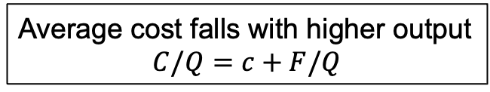
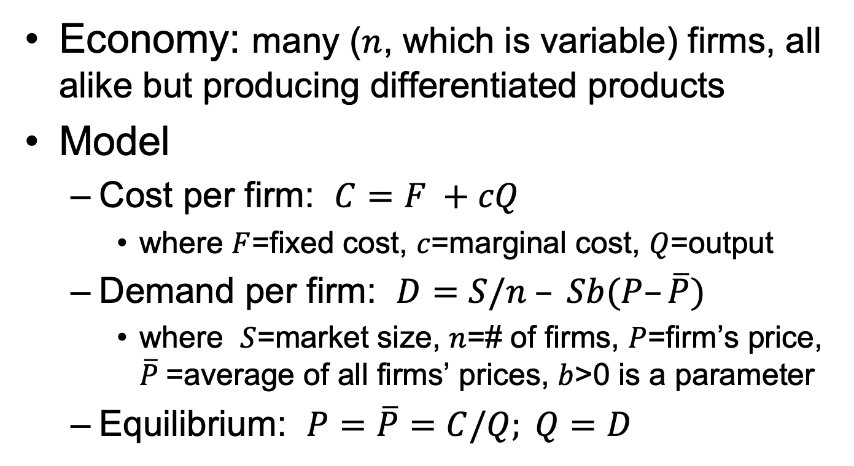
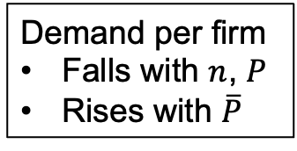
Monopolistic Competition
Economy: many ($n$, which is variable) firms, all alike but producing differentiated products
Model
  Cost per firm: $C=F +cQ$
    where $F$=fixed cost, $c$=marginal cost, $Q$=output
  Demand per firm: $D=S/n – Sb(P–\overline{P})$
    where $S$=market size, $n$=# of firms, $P$=firm’s price, $\overline{P}$=average of all firms’ prices, $b$>0 is a parameter
  Equilibrium: $P=\overline{P}=C/Q; Q=D$
Average cost falls with higher output
$$C/Q=c+F/Q$$
Demand per firm
Falls with $n$, $P$
Rises with $\overline{P}$
Supply = demand
All firms charge same price and make zero profit

Slide 22

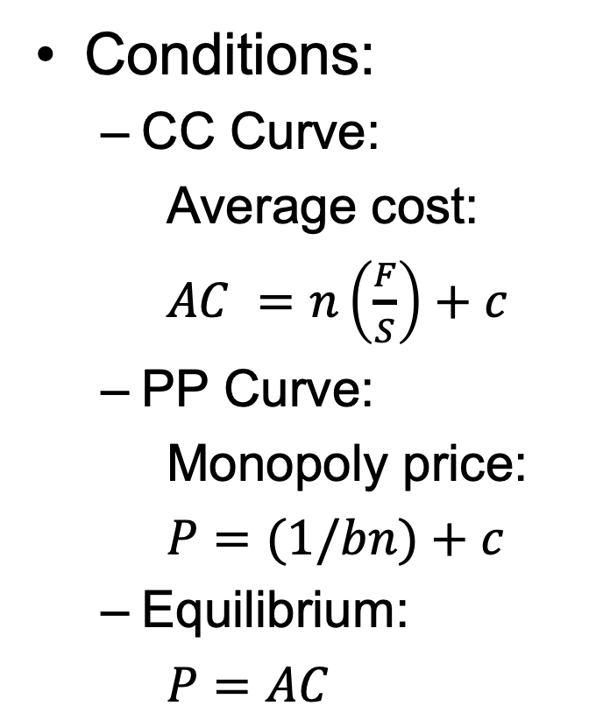







Monopolistic Competition
Conditions:
  CC Curve:
  Average cost:
  $AC =n\left(\frac{F}{S}\right)+c$
  PP Curve:
  Monopoly price:
  $P=(1/bn)+c$
  Equilibrium:
  $P=AC$
$$P, AC$$
  CC: $n(F/S) +c$
$$F/S$$
E
$$P0$$
  PP: $(1/bn)+c$
$$c$$
$$n0$$
$$n$$
Derived in text from MR=MC (marginal revenue = marginal cost)

Slide 23



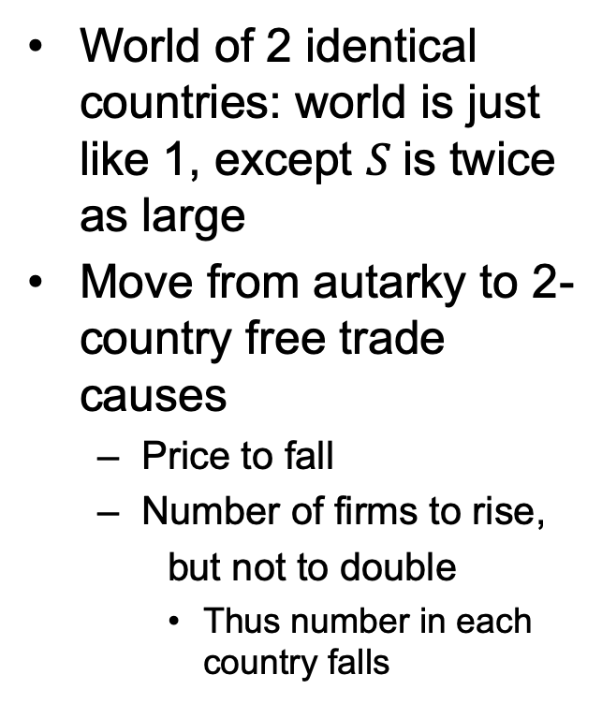



Monopolistic Competition
World of 2 identical countries: world is just like 1, except $S$is twice as large
Move from autarky to 2-country free trade causes
  Price to fall
  Number of firms to rise,
  but not to double
    Thus number in each country falls
$$P, AC$$
  CC: $n(F/S) +c$
$$F/S$$
E
  CC’
$$P0$$
$$F/2S$$
$$P1$$
  PP: $(1/bn)+c$
$$c$$
$$n1/2$$
$$n0$$
$$n1$$
$$2n0$$
$$n$$

Slide 24
Pause for Discussion

Slide 25
  Questions on KOM
Why do “internal economies of scale” lead to imperfect competition?
What two things contribute to the gap between price on a demand curve facing a monopolistic firm and its marginal revenue?
How then is this related to the markups of price above marginal cost that firms charge?

Slide 26
  Questions on KOM
The monopolistic competition model in the text is depicted with two curves, the upward sloping CC curve and the downward sloping PP curve, with the number of firms in the industry, n, on the horizontal axis. What, intuitively, do these two curves represent, and why are they shaped as they are?

Slide 27
  Questions on KOM
What assumption is captured by saying that the equilibrium is the intersection of the CC and PP curves?
Why can the monopolistic competition model lead to trade without comparative advantage?
In the monopolistic competition model, are there any losers from trade?

Slide 28
  Questions on KOM
What are the replacements in the monopolistic competition model of the following three assumptions, and how does each contribute a new reason for gain from trade?
  perfect competition,
  constant returns to scale, and
  product homogeneity

Slide 29
Outline
Scale Economies
Monopolistic Competition
Heterogeneous Firms

Slide 30
Heterogeneous Firms
Old Trade Theory (Ricardo, Heckscher-Ohlin, Specific Factors) had
    Constant returns to scale
    Perfect competition
    Homogeneous products
  Thus firms played no role

Slide 31
Heterogeneous Firms
New Trade Theory (Krugman, etc.) had
    Increasing returns to scale
    Imperfect competition
    Differentiated products
  Firms played important roles, but
  They were assumed identical

Slide 32
Heterogeneous Firms
New, New Trade Theory (Melitz) has
  Most of the assumptions of New Trade Theory, but
  Heterogeneous firms
How?
  Firms differ in their productivities, each coming from a random drawing

Slide 33
Heterogeneous Firms
Other features of a Melitz Model
  Aside from productivity parameters, firms are identical
  Each produces a differentiated product and engages in monopolistic competition
    Hence each firm has zero expected profits (prior to drawing its random productivity)
  There are fixed costs of
    Production, and of
    Exporting

Slide 34
Heterogeneous Firms
Fixed costs of production imply
  Increasing returns to scale
  If productivity is too low (thus cost high), firm
    Won’t sell enough to cover cost
    Will exit
  If productivity is high enough, firm
    Charges lower price
    Makes profit
    Stays in the market

Slide 35
Heterogeneous Firms
Fixed costs of exporting imply
  If productivity is not much above breaking even on domestic market, firm would run a loss if it exported
  Only firms with the highest productivity export

Slide 36
Heterogeneous Firms
Effects of a fall in trade barriers
  Highest-productivity firms, already exporting, expand both output and exports
  High-productivity firms, start to export
  Low productivity firms reduce output
  Lowest productivity firms shut down
Implications of more trade
  Fewer firms, lower prices
  Higher average productivity
Thus a new source of gain from trade!

Slide 37
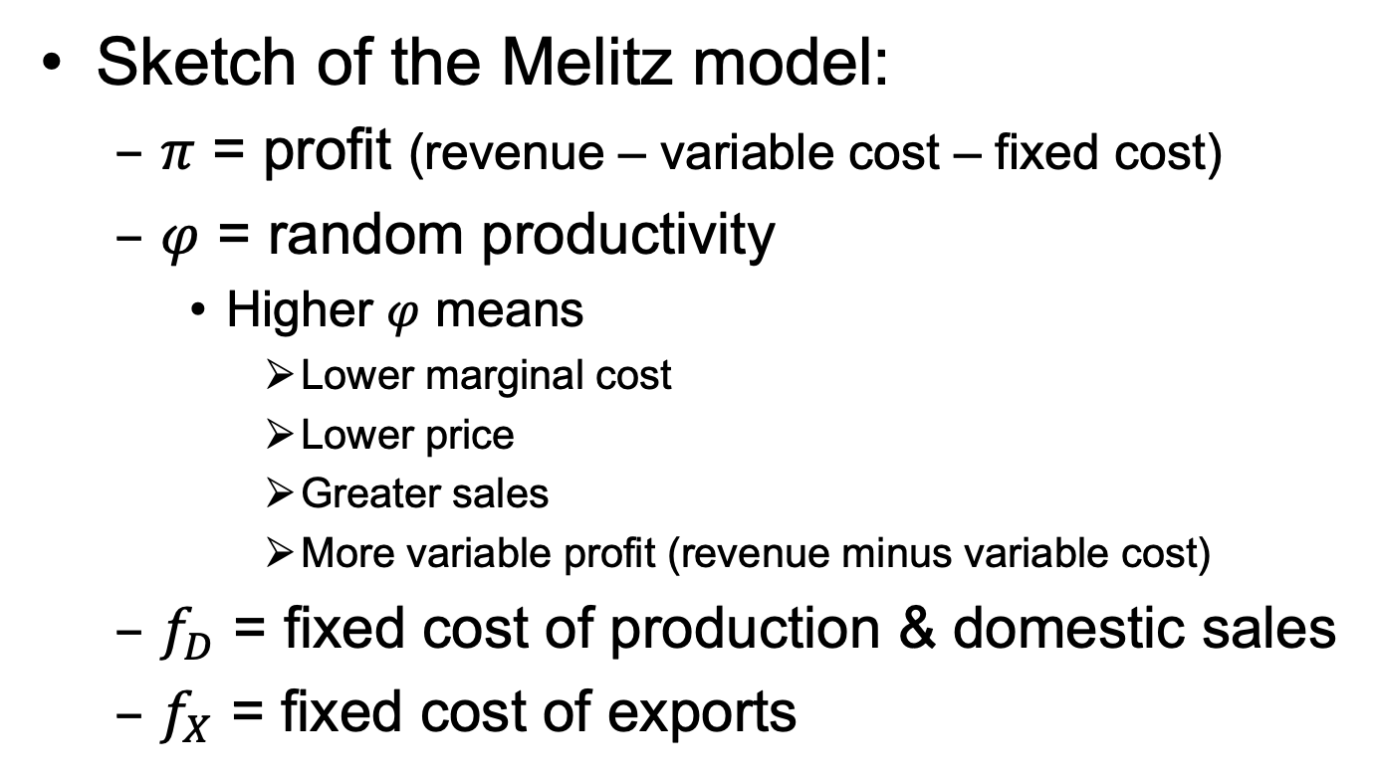
Heterogeneous Firms
Sketch of the Melitz model:
  $π$ = profit (revenue – variable cost – fixed cost)
  $φ$ = random productivity
    Higher $φ$ means
      Lower marginal cost
      Lower price
      Greater sales
      More variable profit (revenue minus variable cost)
  $f_{D}$ = fixed cost of production & domestic sales
  $f_{X}$ = fixed cost of exports
Notes:
Adapted from José Pulido, “El Modelo de Melitz (2003)”, Universidad del Rosario.
https://josepulido.net/wp-content/uploads/Melitz-1.pdf

Slide 38






Equilibrium in Autarky
$$π$$
$$π_{a}$$
Profit
Don’t produce
$$φ_{a}^{∗}$$
$$0$$
$$φ$$
Produce
Productivity
$$f_{D}$$
Notes:
Adapted from José Pulido, “El Modelo de Melitz (2003)”, Universidad del Rosario.
https://josepulido.net/wp-content/uploads/Melitz-1.pdf

Slide 39





Equilibrium with Trade
$$π$$
Profit
$$π$$
$$π_{D}$$
Produce & sell only domestic
$$π_{X}$$
Don’t produce
Produce & sell both domestic and export
$$0$$
$$φ_{D}^{∗}$$
$$φ_{X}^{∗}$$
$$φ$$
$$f_{D}$$
Productivity
$$f_{X}$$
Notes:
Adapted from José Pulido, “El Modelo de Melitz (2003)”, Universidad del Rosario.
https://josepulido.net/wp-content/uploads/Melitz-1.pdf

Slide 40


Move Autarky to Trade
Firms shut down
Profit falls due to greater competition and lower price with trade.
$$π$$
Firms shrink
Firms expand
$$π_{a}$$
Profit
$$π$$
$$π_{D}$$
$$π_{X}$$
$$φ_{a}^{∗}$$
$$0$$
$$φ_{D}^{∗}$$
$$φ_{X}^{∗}$$
$$φ$$
$$f_{D}$$
Productivity
$$f_{X}$$
Notes:
Adapted from José Pulido, “El Modelo de Melitz (2003)”, Universidad del Rosario.
https://josepulido.net/wp-content/uploads/Melitz-1.pdf

Slide 41
Pause for Discussion

Slide 42
  Questions (not asked before)
It seems obvious that firms differ. Why was that not allowed with perfect competition?
Explain the new source of gain from trade that the heterogeneous firm model introduces?

